Slide 1


Sales Performance Analysis for a Retail Store

Slide 2
Project Description
analyze the sales data of a retail store to help them better understand their business performance.
the goal is to provide insights that can improve decision-making.

Slide 3
Data Gathering
the dataset encompasses a wide array of variables, including transaction details (purchase date and customer ID), customer demographics (gender, marital status, homeownership, and children), annual income, geographic information (city, state, country), and product attributes (family, department, and category). It also includes quantitative data on units sold and revenue for each transaction.

Slide 4
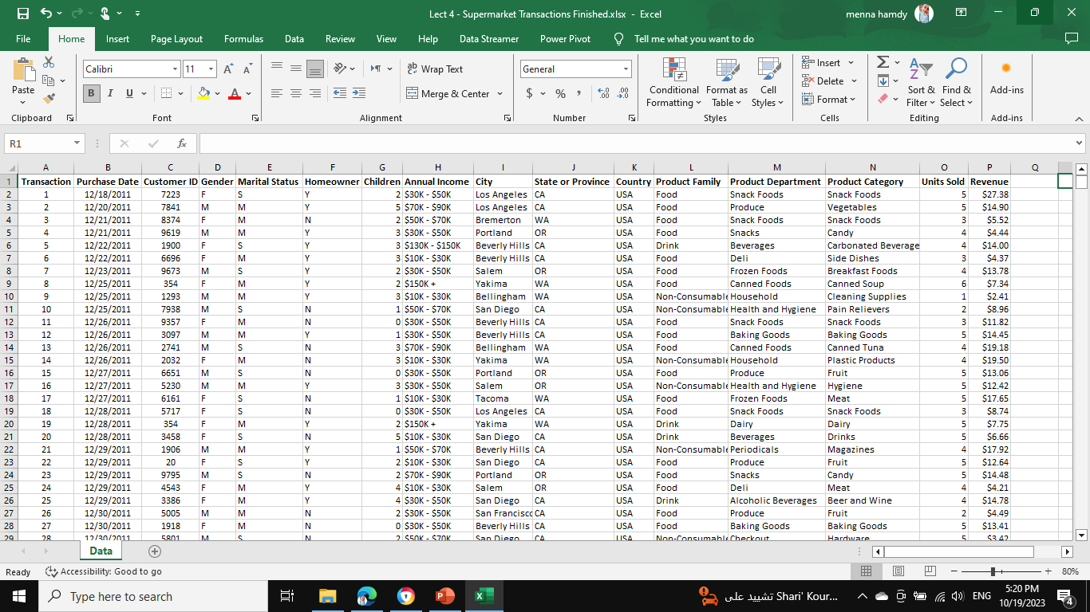

Slide 5
Data Cleaning
removing any duplicates
addressing missing values
fixing formatting issues,

Slide 6
Basic Metrics
we calculated basic sales metrics such as:-
total revenue
average order value
total number of sales
Revenue | $182,830.43
average order value | 4.080588947
total number of sales | $ 57,369.00

Slide 7
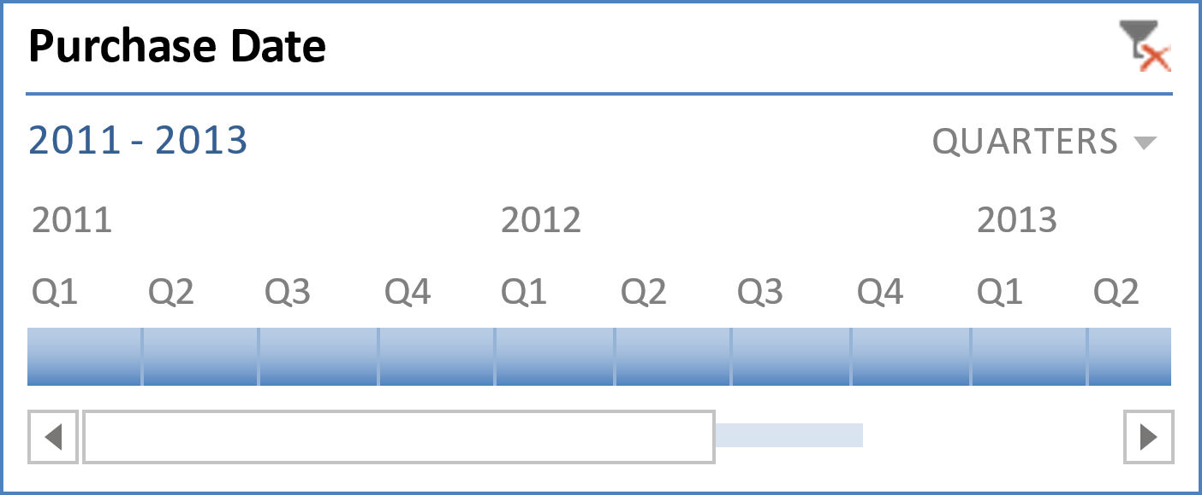
Time Analysis
there is observation that increasing regularly through time until the last month "DEC" in 2013, so try to solve the problem that happen in this month to increase your sales again.
trend and noise data

Slide 8
Product Analysis

Slide 9
Product Analysis

Slide 10
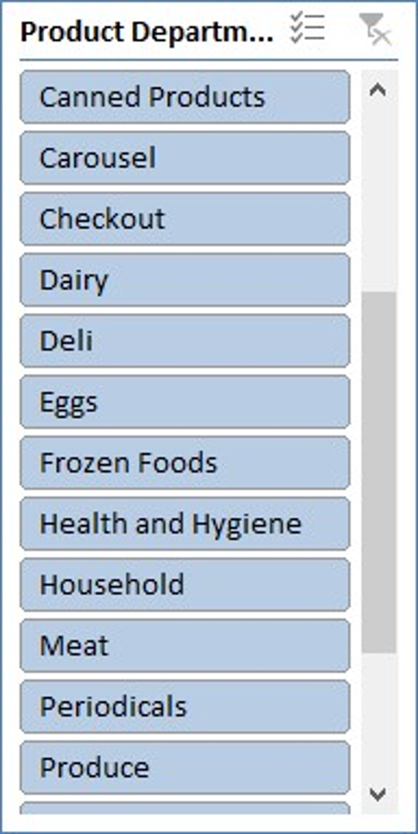
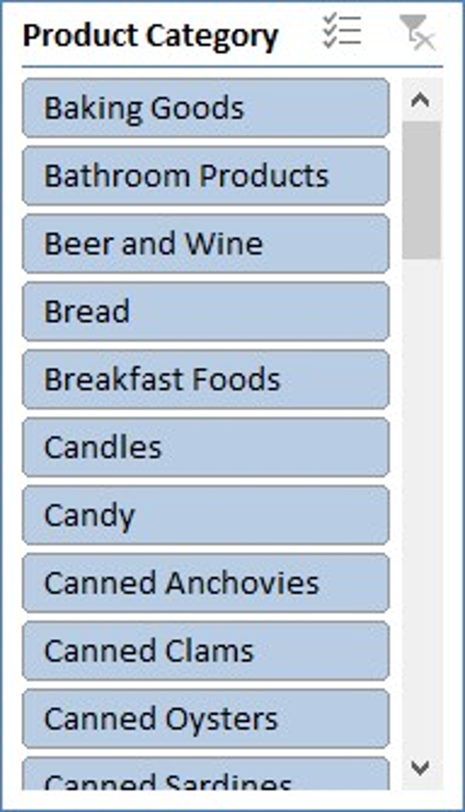
Product Analysis
Notice:
vegetables is top-selling products.
produce is top-selling department.
miscellaneous is slow moving product you must use targeted marketing campaigns and ask for customer feedback to improve your sales.
Adding slicers make it easy in visualization and understanding our sales.

Slide 11
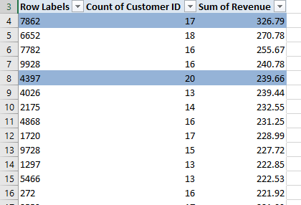
Customer Analysis
=> customer id 4397 is the most loyal customer. He came to the store 20 times and bought with $239.66 during all times.
=> customer id 7862 contribute with the most income to the store, $326.79.

Slide 12
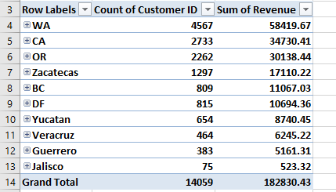
Customer Analysis
=> WA state contribute with the highest income, $58419.67 during our three years.

Slide 13
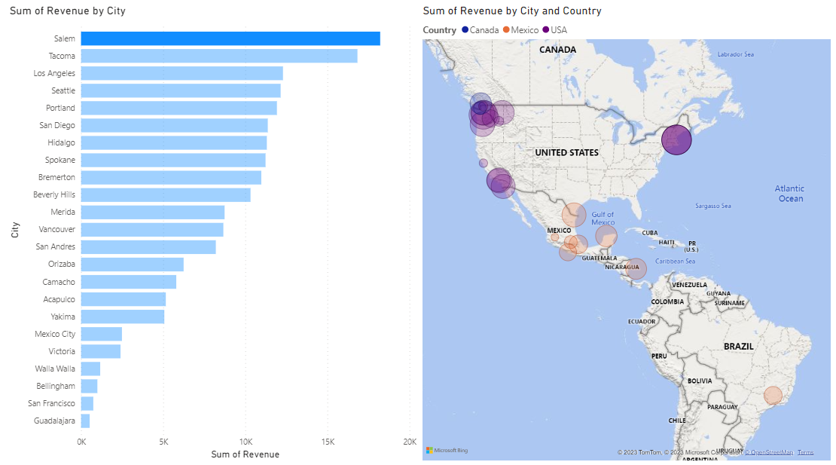
Customer Analysis

Slide 14
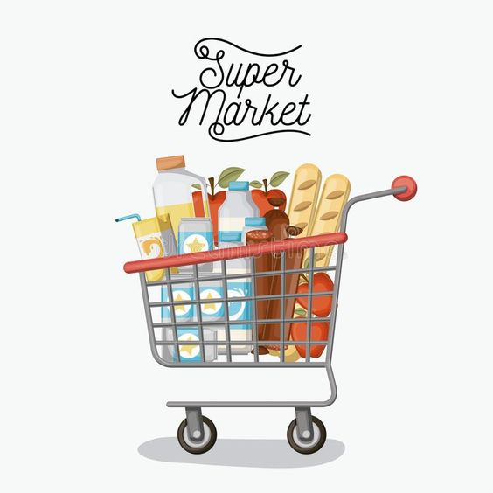
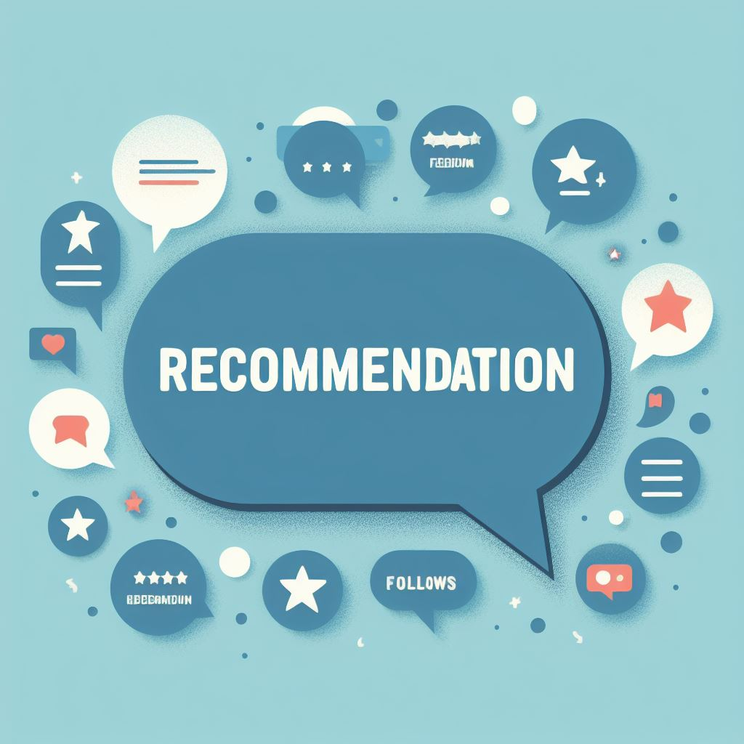
Our recommendations
Targeted Marketing:
Use targeted marketing campaigns, such as email newsletters, social media promotions, or loyalty program incentives, to specifically promote slow-moving products to relevant customer segments.
Customer Loyalty Programs:
Implement a loyalty program to reward frequent shoppers. Points-based systems, exclusive discounts, and personalized offers can encourage repeat business.
Inventory Management:
Optimize inventory management to reduce waste and overstocking. A well-managed inventory ensures that you have what customers need while controlling costs.
Merchandising and Store Layout:
Optimize the store layout to enhance product visibility and accessibility. Place high-margin or popular items at eye level, and create attractive product displays to encourage impulse purchases.

Slide 15
Thank You
mennahamdy431@gmail.com

